Slide 1

FI6121 Lecture Week 10
Volatility Smile & the Heston Stochastic Volatility Model
Dr Barry Sheehan

Slide 2
Lecture Objectives
Volatility Smile
Heston Stochastic Volatility Model

Slide 3
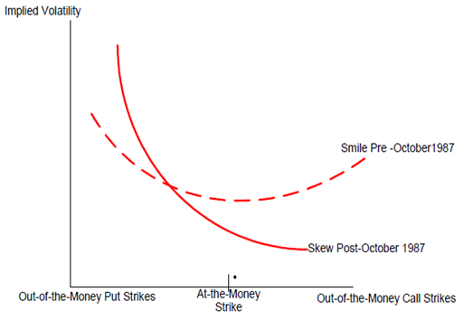
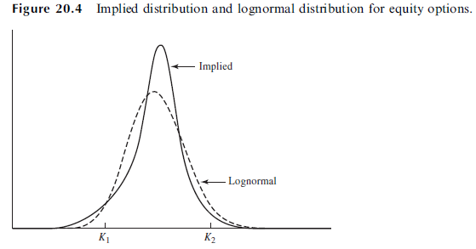
Volatility Smile
implied volatility of an option with a certain life as a function of its strike price:
…The volatility smile for equity options corresponds to the implied probability distribution given by the solid line
A lognormal distribution with the same mean and standard deviation as the implied distribution is shown by the dotted line.
It can be seen that the implied distribution has a heavier left tail and a less heavy right tail than the lognormal distribution.
Notes:
Call-put parity ensures that the implied volatility of a European call option is always the same as the implied volatility of a European put option when the two have:
the same strike price and maturity date.
From Figure 20.4, a deep-out-of-the-money call with a strike price of K2 has a lower price when the implied distribution is used than when the lognormal distribution is used.

Slide 4
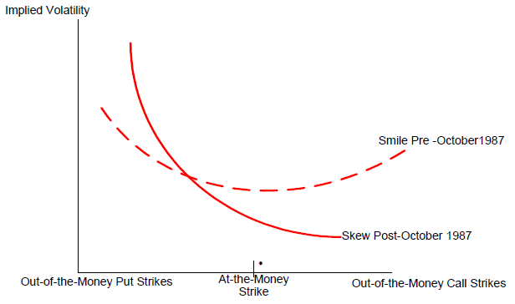
The S&P 500 Implied Volatility Curve Pre-and Post- 1987
The smile has lost its symmetry and it is biased towards the put side.
The change reflects the fact that investors now prize low strike puts more than they do high strike calls.
Why?
Because the October 1987 crash has sensitized the market to the possibility of large downwards jumps in the S&P 500.
Unlikely to be normal if there are large jumps in returns. Jumps fatten the weights of the tails and asymmetric jumps skew the distribution.
Standard deviation of returns is then insufficient to characterize risk and the probability of returns two or three standard deviations below the mean is not negligible, as it is under a normal distribution.

Slide 5
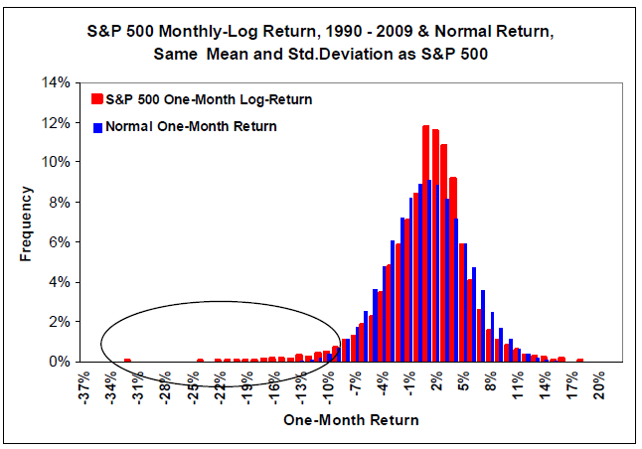
Frequency Distribution of S&P 500 Log-Return
S&P 500 distribution is far from normal
It carries “tail risk”:
(a) the frequency of outlier returns is greater than for a normal distribution, and
(b) the distribution has a negative skew.
This means that VIX, a proxy for the standard deviation of the S&P 500 distribution, may not fully capture the perceived risk of a cash or derivative investment in the S&P 500 or in correlated assets.

Slide 6
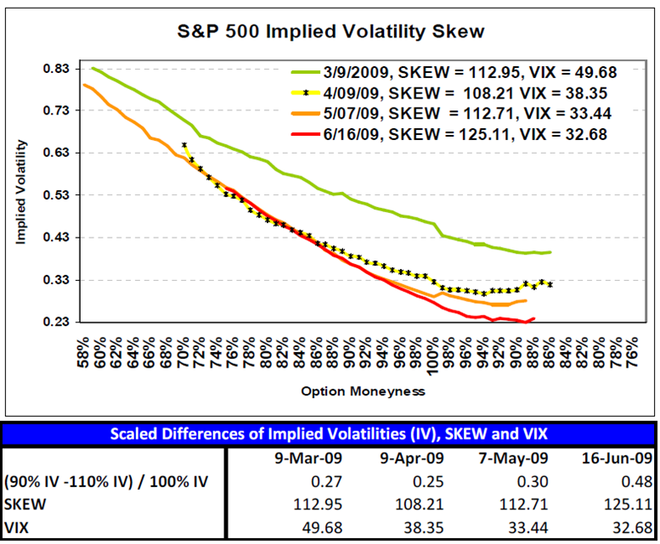
CBOE Skew Index (SKEW)
SKEW is a global, strike independent measure of the slope of the implied volatility curve
Increases as this curve tends to steepen
S&P 500 implied volatility curve, SKEW and the CBOE Volatility Index® (VIX®) from March 2009 to June 2009.
There is no significant change in SKEW or the overall slope of the implied volatility curve between March and May 2009.
By mid-June, SKEW is significantly higher, and the implied volatility curve is noticeably steeper.

Slide 7


CBOE Skew Index (SKEW)
SKEW is derived from the price of S&P 500 skewness, denoted by S.
S is defined similarly to a coefficient of statistical skewness:
Since S tends to be negative and to vary within a narrow range (-4.69 to - .10 between 1990 and 2010), it is transformed to SKEW by the following linear function:
With this definition, SKEW increases as S becomes more negative and tail risk increases.
SKEW is a global, strike independent measure of the slope of the implied volatility curve
Increases as this curve tends to steepen

Slide 8
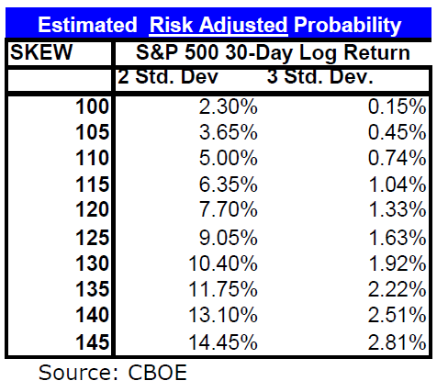
Interpretation of the SKEW
When SKEW is equal to 100:
Distribution of log-returns is normal
the probability of returns two standard deviations below or above the mean is 4.6% (2.3% on each side);
the probability decreases to .3% (.15% on each side) for three standard deviations.
When SKEW increases to 145:
Distribution of log-returns is non-normal
the probability of returns two standard deviations below or above the mean is 28.9% (14.45% on each side);
the probability decreases to 5.62% (2.81% on each side) for three standard deviations.
Notes:
2/3 STD below mean

Slide 9
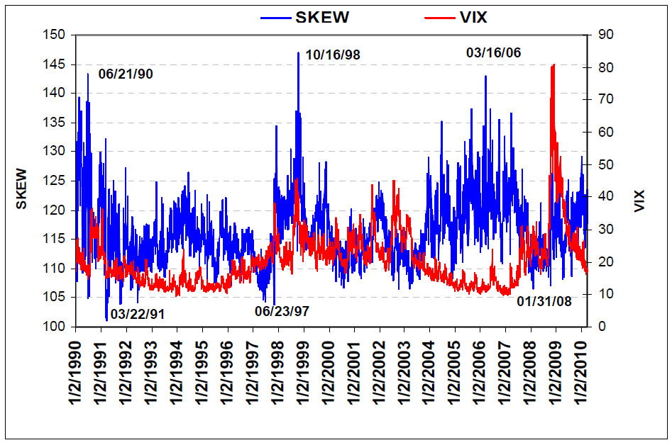
VIX & SKEW
VIX:
Proxy for the standard deviation
Captures the first layer of perceived risk, as it tells how far on average the S&P 500 log-return is likely to stray on either side of its mean, including the risky downside
SKEW:
Catches the additional layer of risk implied by the left tail of the distribution.

Slide 10
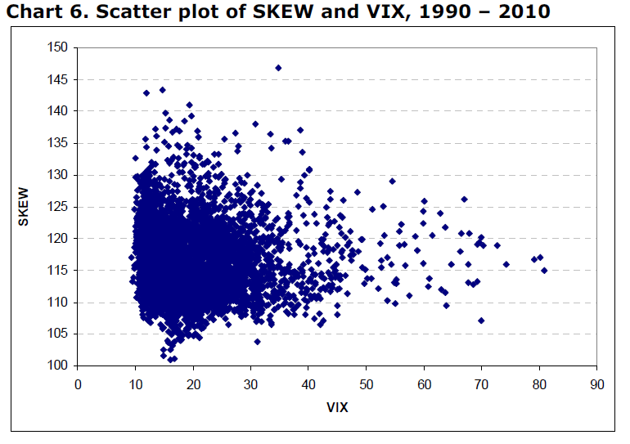
VIX & SKEW
Perceived tail risk increases when market participants increase their probability of a catastrophic market decline, what has come to be called a “black swan”.
Scatter plot of VIX and SKEW, high values of SKEW occur in conjunction with both low or high values of VIX.
Note that the upper bound of SKEW values decreases as VIX rises to extreme values above 40.
The probable reason is that VIX surges during periods of crashing stock prices, when a repeat crash may not be viewed as that likely.

Slide 11
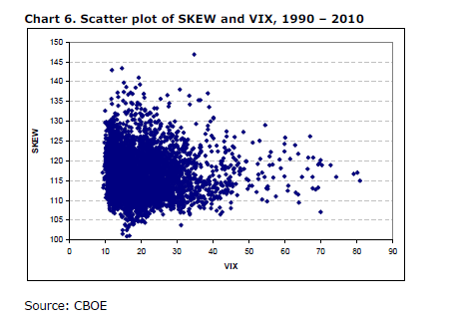
Why does the upper bound on SKEW index fall as the level of VIX increases ?

Slide 12
Why does the upper bound on the CBOE SKEW index fall as the level of the VIX index increases ?
Moderate to high VIX values, likely that the market hasn’t yet crashed though fears are moderate to high => relatively more likely for a single Black-Swan event to yet occur going forward.
For VIX > 40%, these are extremely high VIX values, and probably reflect that the market has been already nose-diving at these points in time, i.e. earthquake equivalent to volcano sides venting-off pressure => relatively less likely for a major eruption or cataclysmic Black-Swan event going forward. Hence, the CBOE SKEW Index implied probability measure of (lower left) tail risk should be lower than before.

Slide 13
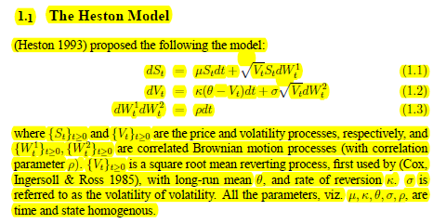
Heston Stochastic Volatility Model
Correlation between dW₁ and dW₂ = E[dW₁.dW₂] = ρ.dt
Notes:
Allows arbitrary correlation between volatility and spot asset returns.
Simulations show that correlation between volatility and the spot asset's price is important for explaining return skewness and strike-price biases in the Black-Scholes (1973) model.
higher variance v(t) raises the prices of all options, just as it does in the Black-Scholes model

Slide 14
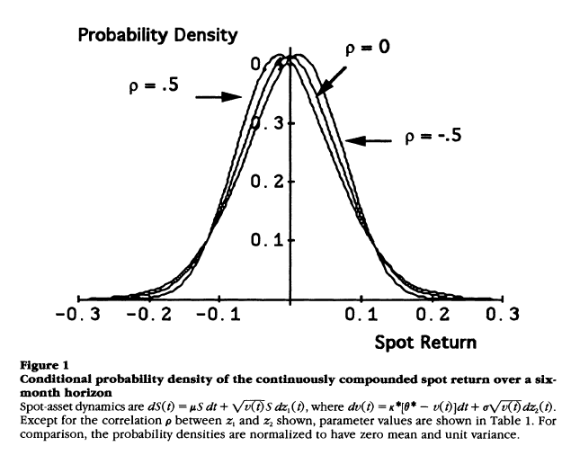
Effect of the Heston Parameters
The correlation parameter p positively affects the skewness of spot returns.
Intuitively, a positive correlation results in high variance when the spot asset rises, and this "spreads" the right tail of the probability density.
Conversely, the left tail is associated with low variance and is not spread out.
Figure 1 shows how a positive correlation of volatility with the spot return creates a fat right tail and a thin left tail in the distribution of continuously compounded spot returns

Slide 15
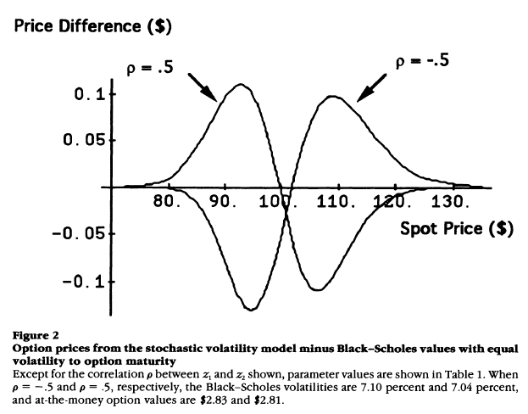
Effect of the Heston Parameters
Figure 2 shows that this increases the prices of out-of-the-money options and decreases the prices of in-the-money options relative to the Black-Scholes model with comparable volatility.
A negative correlation has completely opposite effects. It decreases the prices of out-of-the-money options relative to in-the-money options.

Slide 16
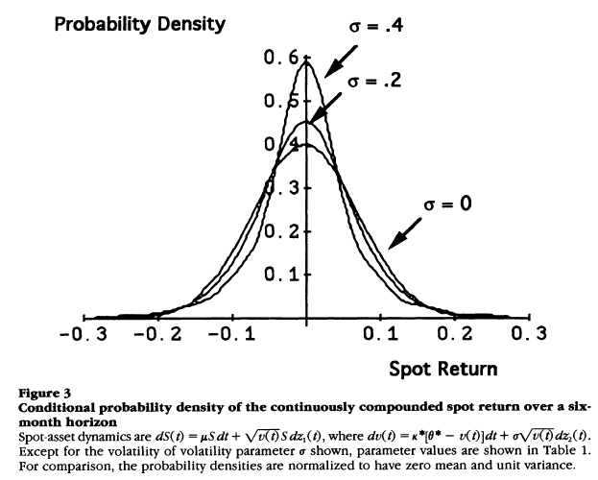
Effect of the Heston Parameters
The σ parameter a controls the volatility of volatility:
When a is zero, the volatility is deterministic, and continuously compounded spot returns have a normal distribution.
Otherwise, σ increases the kurtosis of spot returns
This has the effect of raising far-in-the-money and far-out-of-the-money option prices and lowering near-the-money prices.

Slide 17
How Heston SV model corrects a pricing bias in BS model … the underpricing of OTM Puts
Heston
Black-Scholes
●
S_{T} < X
X
OTM Put (Call) prices are most sensitive to the probability area in the lower left (upper right) tail of the probability distribution. WHY ?
OTM Put price = discounted, expected payoff at maturity !
Under Heston SV model … the expected payoff at maturity “ = “ [X-S_{T}] x Pr.[S_{T}<X] … latter term is cumulative probability under the red PDF curve to left of X.
Higher model price of OTM Put in Heston means a higher implied volatility.

